Slide 1
SQLI FINDER TOOL
BY-Siddharth Verma (19-CSE-113)
Abhinav Chauhan (19-CSE-05)

Slide 2
CONTENT
Introduction
Web Application Security
Why is Web Security Testing important
Majority of Web Application Attecks
What is Sql Injection
How to use sqlifinder tool in Kali linux
Features
Conclusion
Working Screenshot

Slide 3
Introduction
sqlifinder is a tool with the function of detecting GET-based sql injection vulnerabilities in web applications using waybackurls, web crawlers and sql injection payloads.
sqlifinder is a python tool that helps IT teams find Sql injection from Web application. It supports Windows, Linux, and Mac operating .
It also offers automatic injection of 33 database engines including Access, DB2, Hana, Ingres, MySQL, Oracle, PostgreSQL, SQL Server, Sybase, and Teradata. It provides the user with ways to address multiple injection strategies and processes and offers script sandboxes for SQL and tampering. .

Slide 4
WEB APPLICATION SECURITY
Web application security (also known as Web AppSec) is the idea of building websites to function as expected, even when they are under attack. The concept involves a collection of security controls engineered into a Web application to protect its assets from potentially malicious agents. Web applications, like all software, inevitably contain defects. Some of these defects constitute actual vulnerabilities that can be exploited, introducing risks to organizations. Web application security defends against such defects. It involves leveraging secure development practices and implementing security measures throughout the software development life cycle (SDLC), ensuring that design-level flaws and implementation-level bugs are addressed.

Slide 5
Why is web security testing important?
Web security testing aims to find security vulnerabilities in Web applications and their configuration. The primary target is the application layer (i.e., what is running on the HTTP protocol). Testing the security of a Web application often involves sending different types of input to provoke errors and make the system behave in unexpected ways. These so called “negative tests” examine whether the system is doing something it isn’t designed to do.
It is also important to understand that Web security testing is not only about testing the security features (e.g., authentication and authorization) that may be implemented in the application. It is equally important to test that other features are implemented in a secure way (e.g., business logic and the use of proper input validation and output encoding). The goal is to ensure that the functions exposed in the Web application are secure.

Slide 6
Majority of Web Application Attacks
SQL Injection
XSS (Cross Site Scripting)
Remote Command Execution
Path Traversal
SSRF
IDOR
HTML Injection
Broken access control

Slide 7
What is SQL Injection?
SQLi (SQL Injection) is an technique where hacker executes the malicious SQL statements to take over the website. It is considered as high severity vulnerability, and the latest report by Acunetix shows 8% of the scanned target was vulnerable from it.
Many web applications take user input from a form
Often this user input is used literally in the construction of a SQL query submitted to a database. For example:
SELECT user FROM table WHERE name = ‘user_input’;
An SQL injection attack involves placing SQL statements in the user input

Slide 8
HOW TO USE SQLIFINDER TOOL IN LINUX
Sqlifinder requires:
python3
huepy
requests
tqdm
To install run these comands:
sudo apt install git
Git clone https://github.com/vsidharth2001/Sqlifinder.git
cd sqlifinder
pip3 install -r requirements.txt
To run the tool on a target, just use the following command.
▶ python3 sqlifinder.py -d example.com
The command can be used to test sql injection in subdomains of the target.
▶ python3 sqlifinder -d example.com -s

Slide 9
FEATURES
It has fast and powerful scanner.
It Include’s web crawler and wayback urls.
It reduce manual effort by automatically finding infected website parameters.
It is a lightweight software that can be handled by any processor and penetration tester.

Slide 10
CONCLUSION
We can see that if a site is vulnerable for sql injection.
Similarly we can see if any company’s website has vulnerable for sql injection which can result in data breaches from the company database.
This tool can successfully run on systems having Kali LINUX.

Slide 11
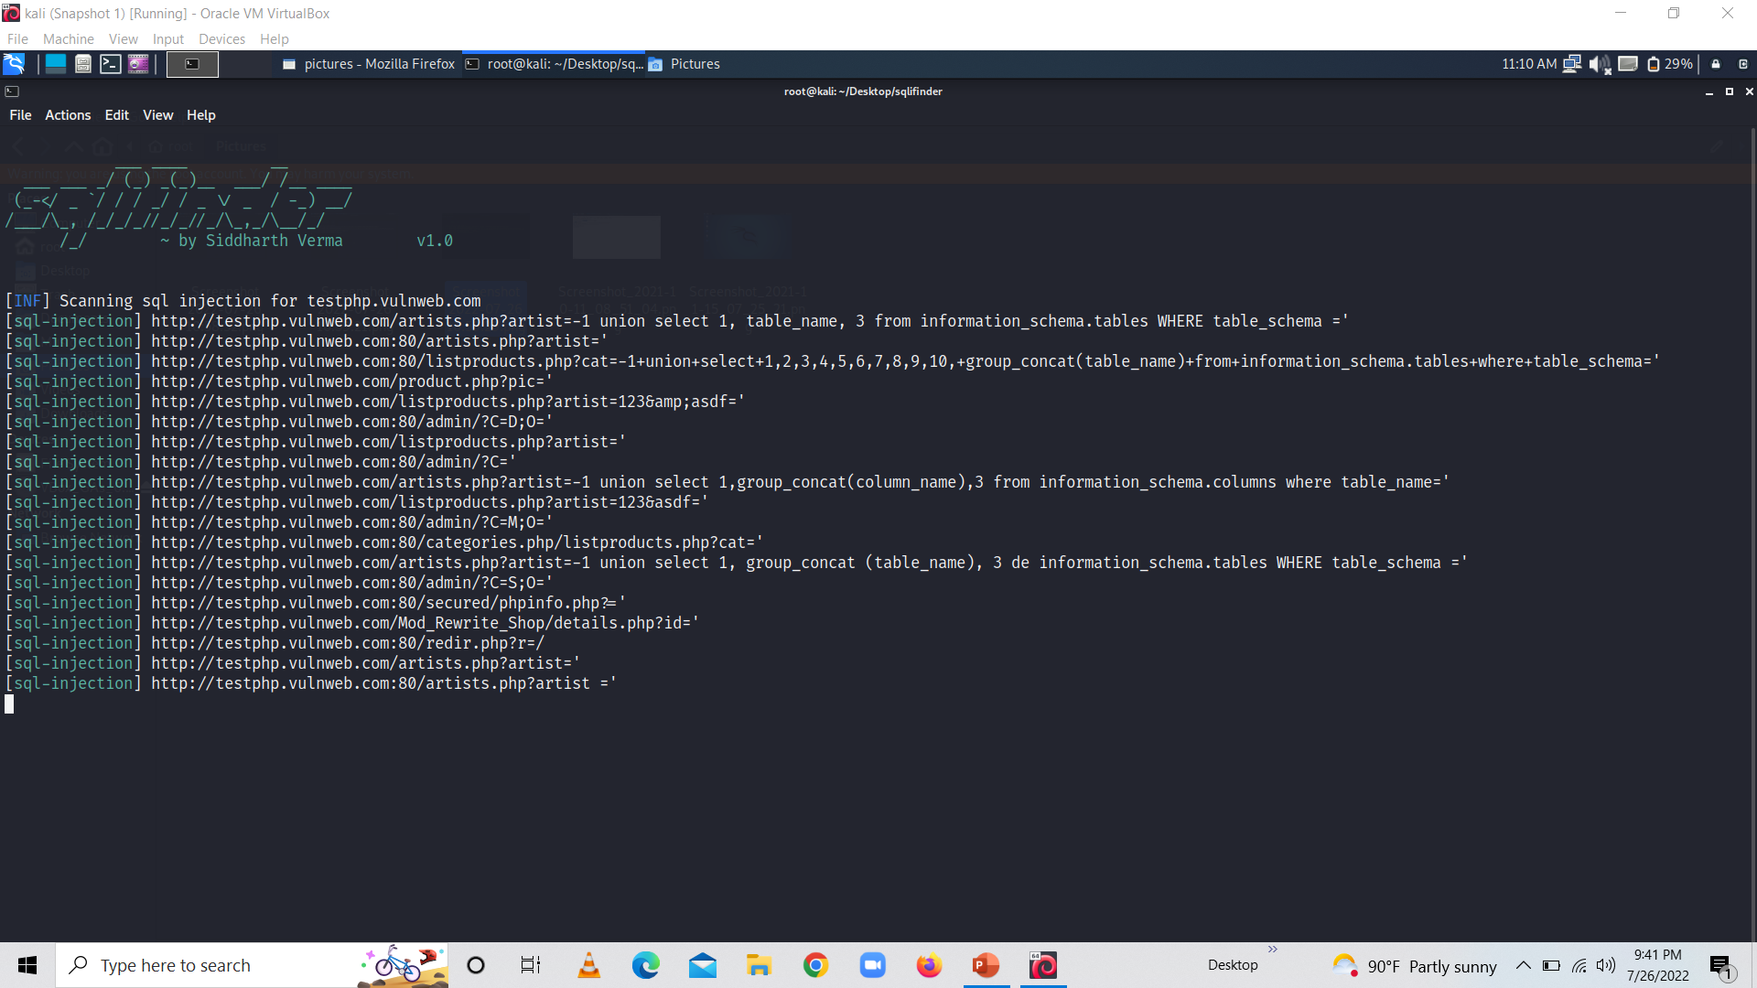
Working Screenshot
Picture below is showing which parameter are vulnerable for sql injection

Slide 12


